Slide 1
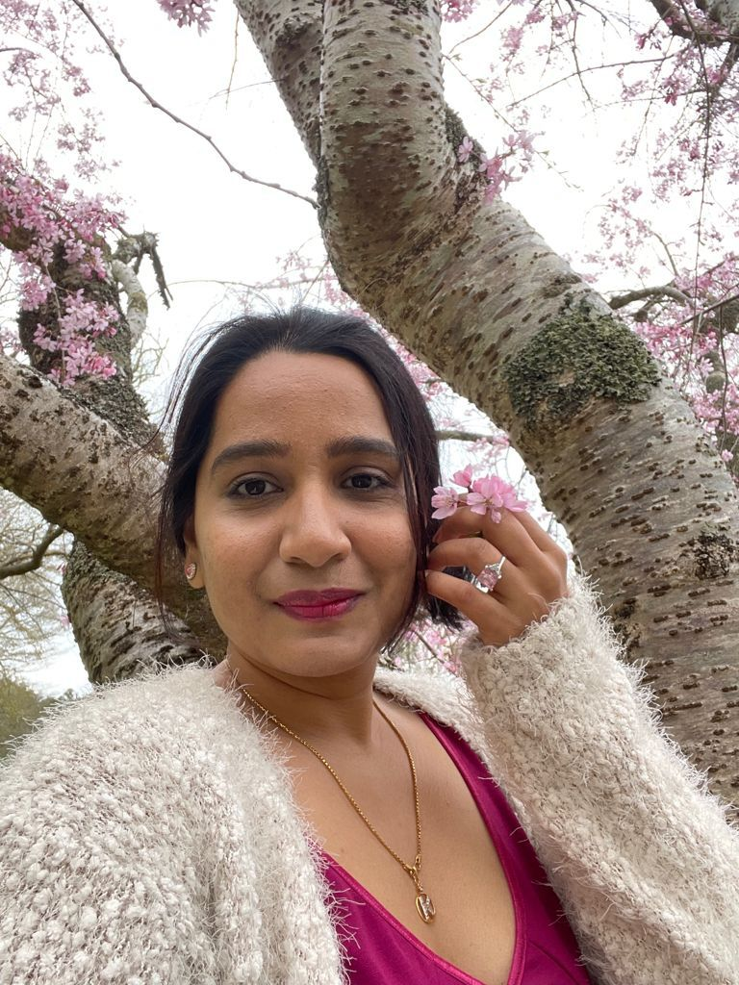


_{Fresh Look, Beauty Parlor}
_{No 39/A, New Street,}
_{Arakkonam - Ocheri Rd,}
_{Nagavedu, Arakkonam,}
_{Tamil Nadu 631002}
_{Customer Care}
₊₉₁ ₍₈₂₂₎₋₀₀₆₋₁₀₀₁
₊₉₁ ₍₈₀₉₎₋₈₈₈₋₉₄₉₄
_{freshlookdesk@gmail.com}
Fresh Look
Beauty Parlor
Download Now!
Kirty Singh

Slide 2


Kirty Singh

Slide 3
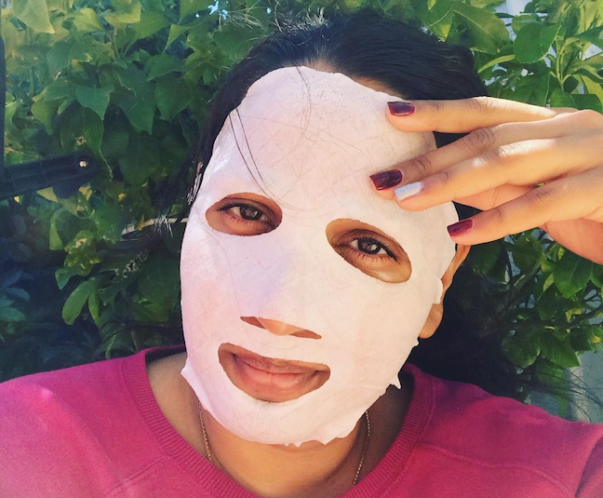
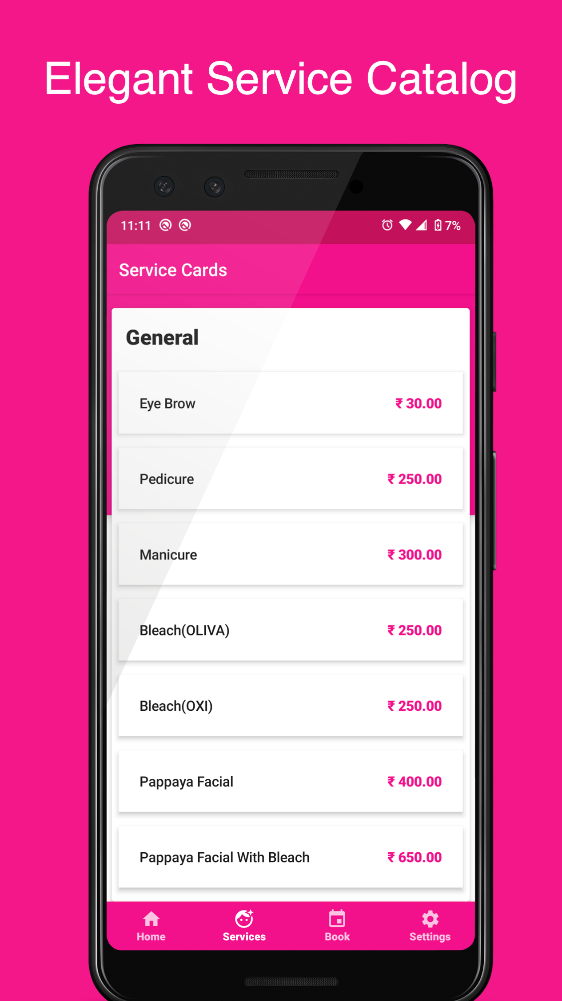
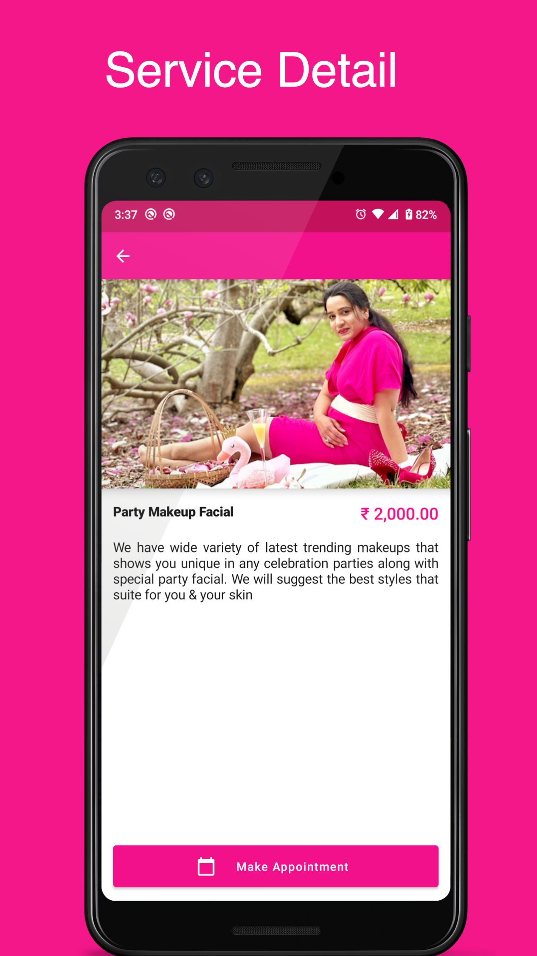
Kirty Singh

Slide 4
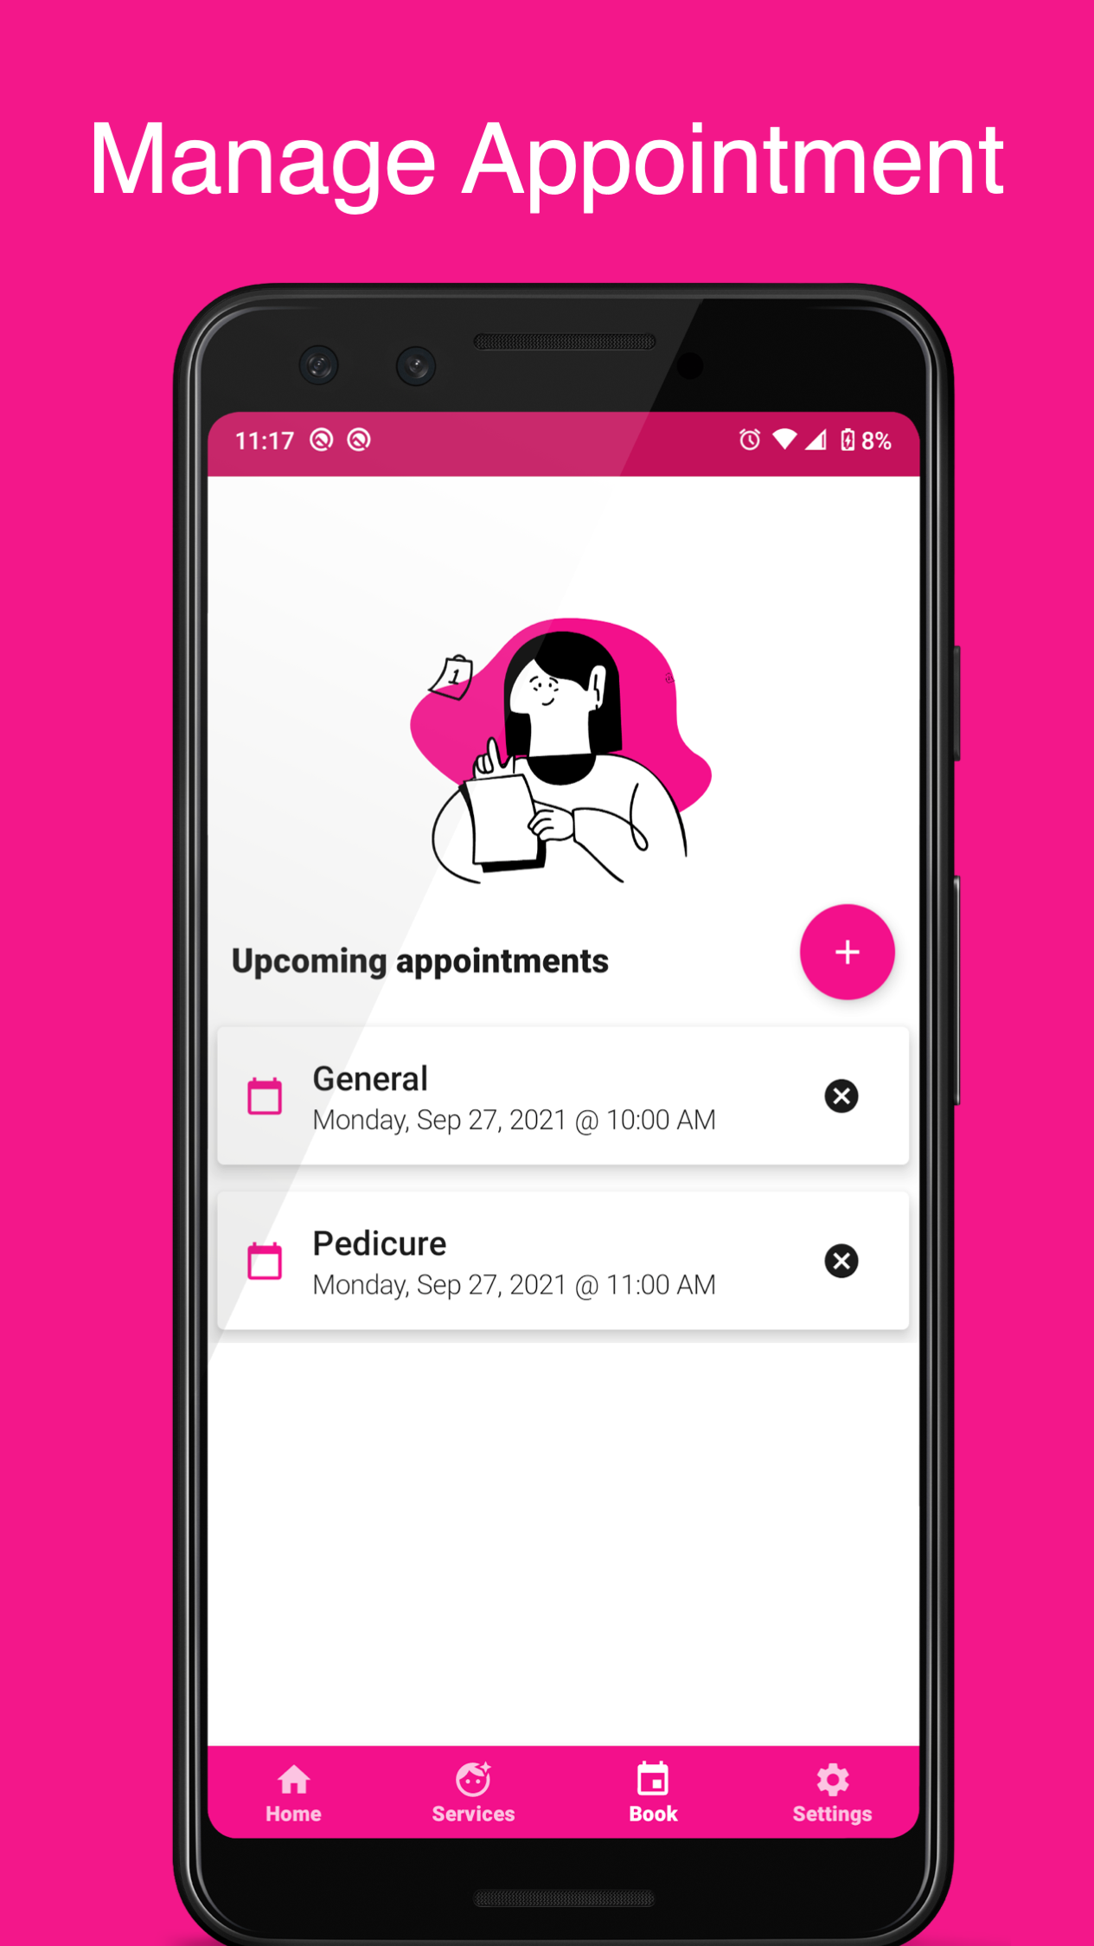
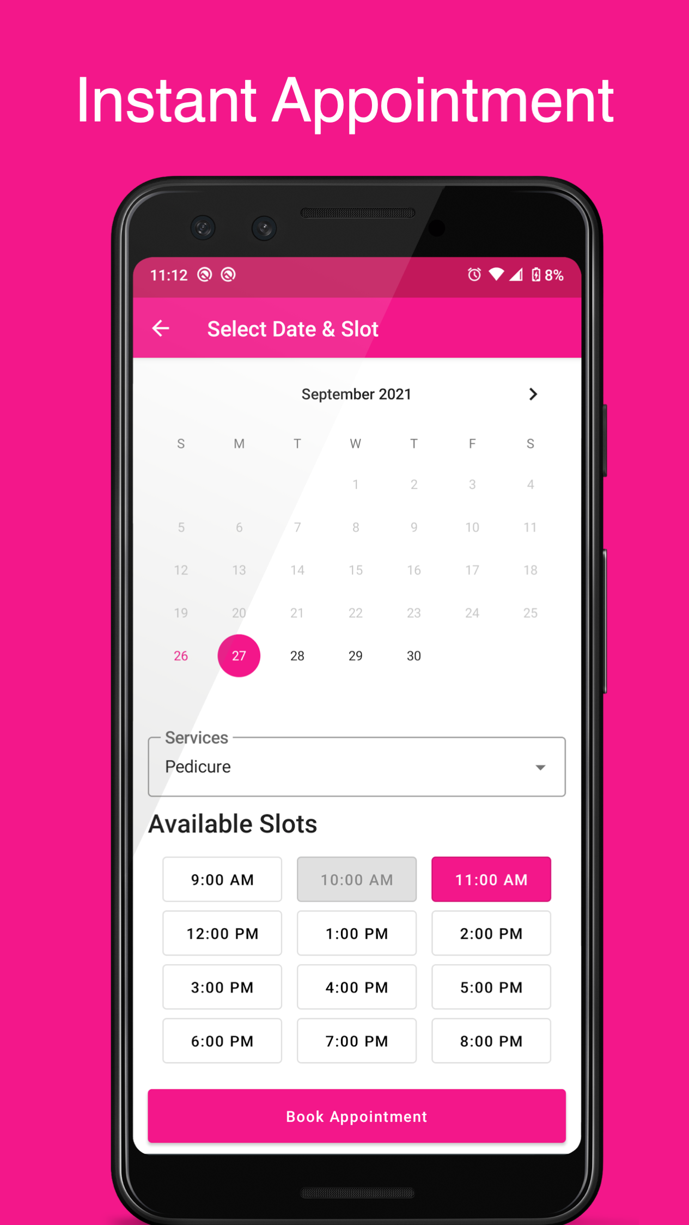
Kirty Singh

Slide 5
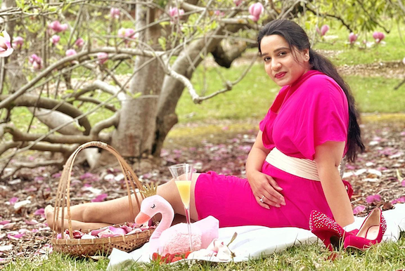
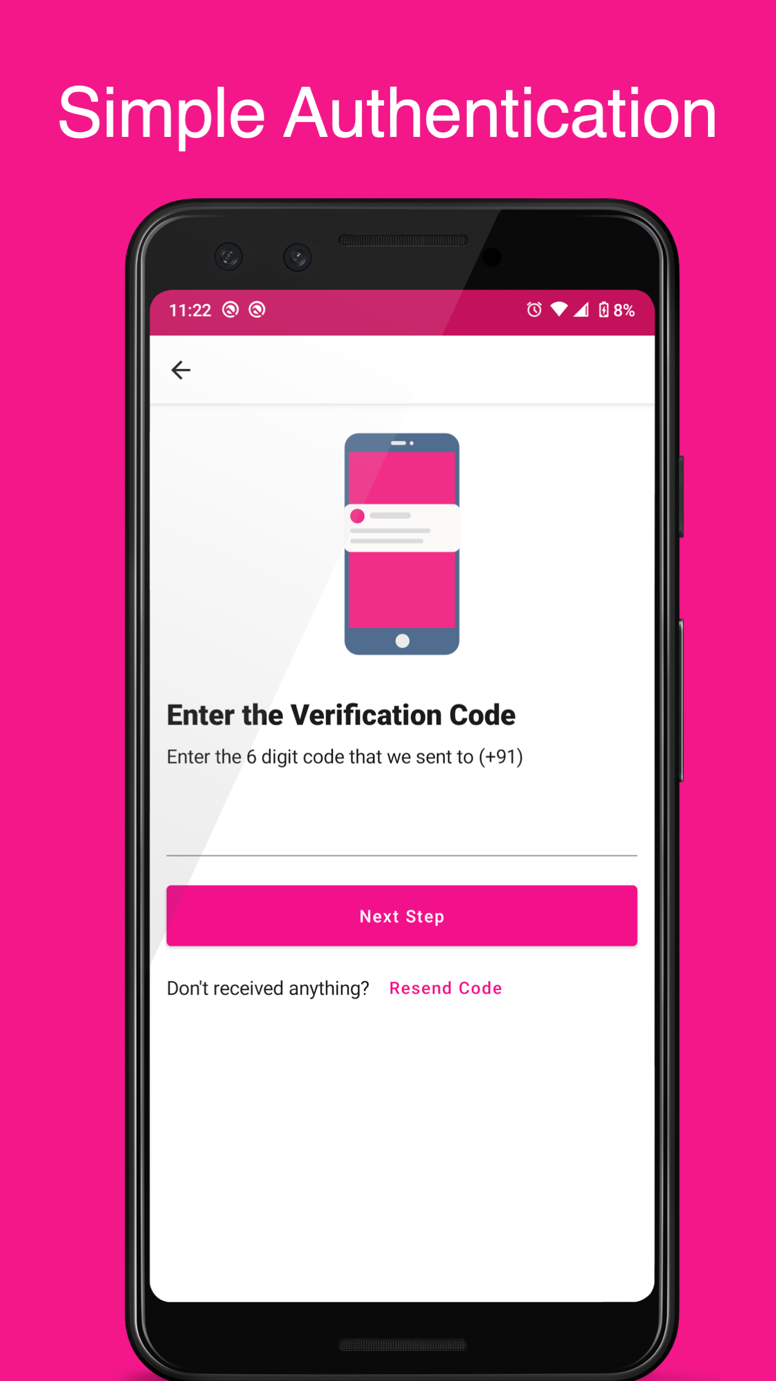

Kirty Singh

Slide 6
Kirty Singh

